Slide 1

F1 Grand Prix Race Win Predictor – Sprint 3

Slide 2




Reintroduction to the Problem Space
Predicting F1 winner: complex problem
Binary classification problem : Win (1) or Not Win (0)
Models for Sprint 3
Logistic Regression
Decision Tree
Random Forest
XG Boost
Notes:
Classification problem – predicting race winners
This is a binary problem – win or don’t win
In sprint 2, the plan was to use 3 types of models to get some modelling done for the project and get some benchmarks

Slide 4



Data Overview and Changes
Dataset V3: more feature engineering
Encoding Changes: e.g. constructorId
New Features: e.g. age, years in F1
Years with team: for predictive relevance.
Notes:
During Sprint 3, we refined our dataset, focusing on features that could predict race outcomes before they happen.
Constructor ID, was label encoded and this moved to one hot encoding
Feature engineering was a major step in this phase. We created new variables to encapsulate the cumulative performance across the season, both for constructors and drivers, which are significant predictors of race-winning likelihood.
We addressed missing values, non-useful columns and eliminated duplicates, which not only cleans the data but also helps to prevent model biases that could distort the predictions.

Slide 5
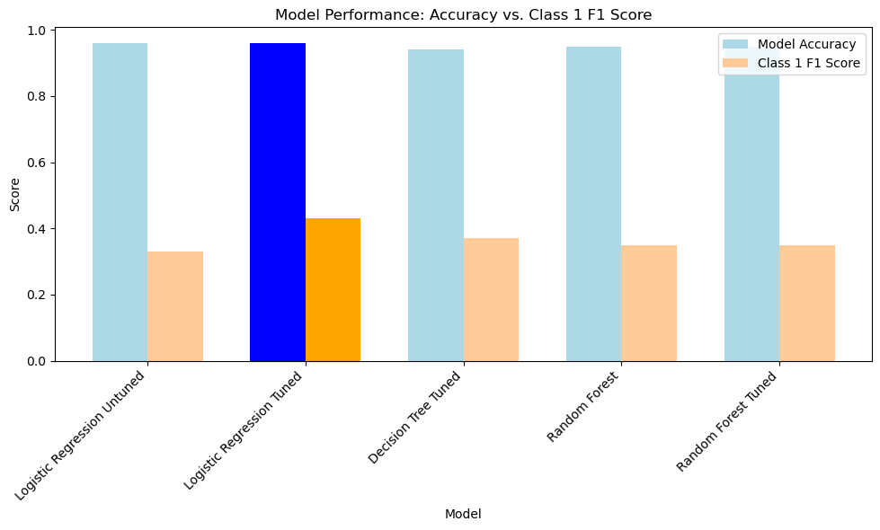
What Model performed the best?
PLACEHOLDER CHART
Notes:
Showcases how the 'Logistic Regression Tuned' model outperforms others in both model accuracy and Class 1 F1 Score It's visually distinct with bright blue and orange bars
Important to note that a naïve model would be to always guess “non-win” and you will be right 95% of the time, but you wouldn’t be able to predict a winner
Logistic Regression Model had 95% accuracy, but (recall of 32% and Precision of 64%) for predicting winners, so at least we are picking winners.

Slide 6
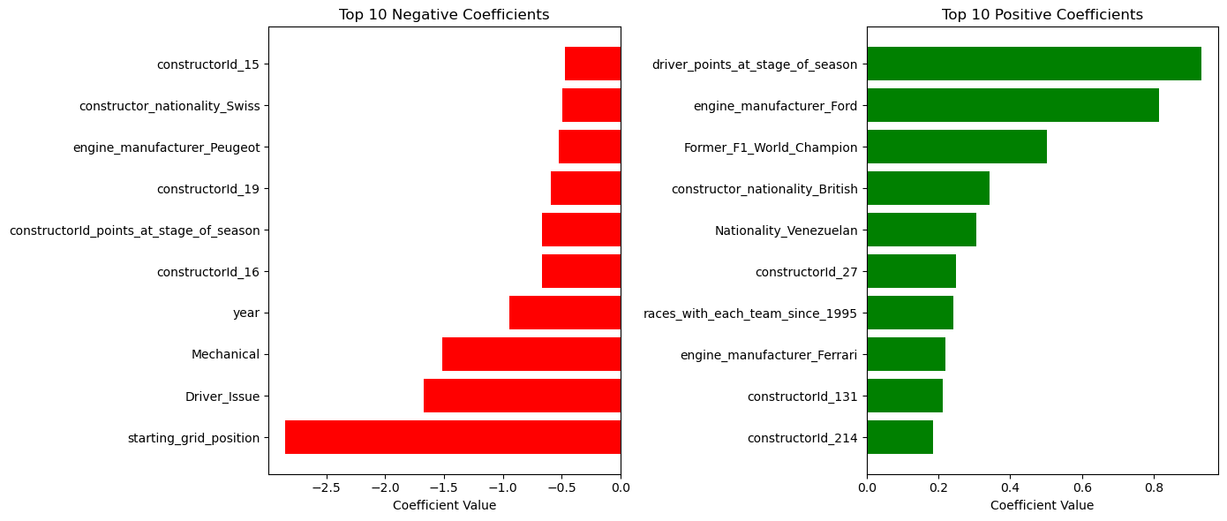
What factors influence wins…

Slide 7
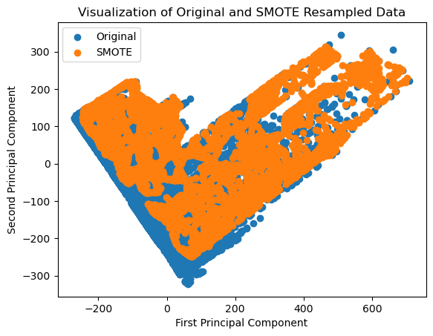
Data Pit Stop: SMOTE's Role in Tuning Predictive Models
Notes:
The slide displays a scatter plot of the original dataset against the SMOTE resampled data, visualized through principal component analysis (PCA).
PCA reduces the data to two dimensions, labeled here as the 'First Principal Component' and 'Second Principal Component,' which capture the most variance within the dataset, allowing us to see patterns and clusters more clearly.
SMOTE, or Synthetic Minority Over-sampling Technique, is illustrated by the orange dots, showing how it populates the data space with synthetic points to balance the classes.
This balance achieved by SMOTE is crucial for building robust models because it helps to prevent the model from being biased towards the majority class.

Slide 8
Would I have won any money?
Notes:
The charts compares the performance of different predictive models based on their accuracy and precision in classifying F1 race outcomes.
The Random Forest SMOTE model stands out as the best so far, with a balance between model accuracy (95%) and class 1 F1 score (0.49), indicating a strong performance in both classes of predictions.
The benchmark mentioned suggests that simply predicting that a race will not be won (likely referring to a specific driver or team) would result in a 95% accuracy rate. This highlights the imbalance in the dataset, where a naïve model with a one-sided prediction could appear deceptively effective.
The SMOTE technique, which stands for Synthetic Minority Over-sampling Technique, has been applied to Logistic Regression and Decision Tree models as well, but the Random Forest with SMOTE yields better performance metrics, specifically in Class 1 precision and F1 score, demonstrating its effectiveness in handling class imbalance for this specific prediction task.

Slide 9
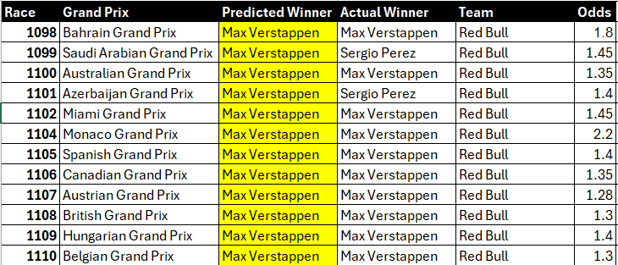
Model Interpretation
Where did the model make mistakes?
Which races didn’t the model get right?
Notes:
Feature Engineering : type of circuit (street vs racetrack) or the age of the driver at the time of the race
Other methods for class imbalance : SMOTE + TOMEK and SMOTE + ENN (they might be other avenues I decide to go down)
Other models : XG Boost and NN
Profit and Lost : Would the
Feature engineering was a major step in this phase. We created new variables to encapsulate the cumulative performance across the season, both for constructors and drivers, which are significant predictors of race-winning likelihood.

Slide 10
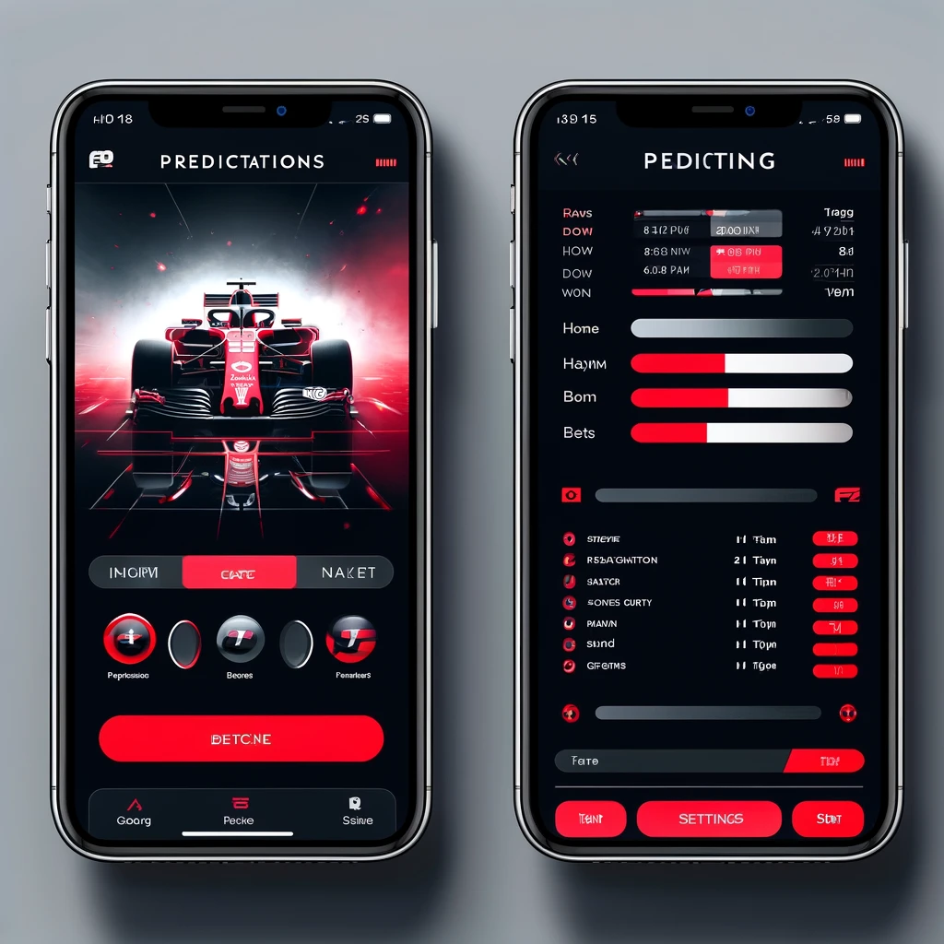
Product Design Idea
Notes:
Feature Engineering : type of circuit (street vs racetrack) or the age of the driver at the time of the race
Other methods for class imbalance : SMOTE + TOMEK and SMOTE + ENN (they might be other avenues I decide to go down)
Other models : XG Boost and NN
Profit and Lost : Would the
Feature engineering was a major step in this phase. We created new variables to encapsulate the cumulative performance across the season, both for constructors and drivers, which are significant predictors of race-winning likelihood.

Slide 11


Thanks for your time

Slide 12

Notes:
"Home Screen: Welcome Message: A brief intro about the app's purpose, leveraging F1 colors and imagery for brand alignment. Latest Predictions: A dynamic section showcasing the AI's latest predictions for the upcoming race, summarizing key insights from Veronica's project. User Prediction Input: A section where users can input their own predictions, with autocomplete suggestions for driver names."
See next slide as well for some information about

Slide 13
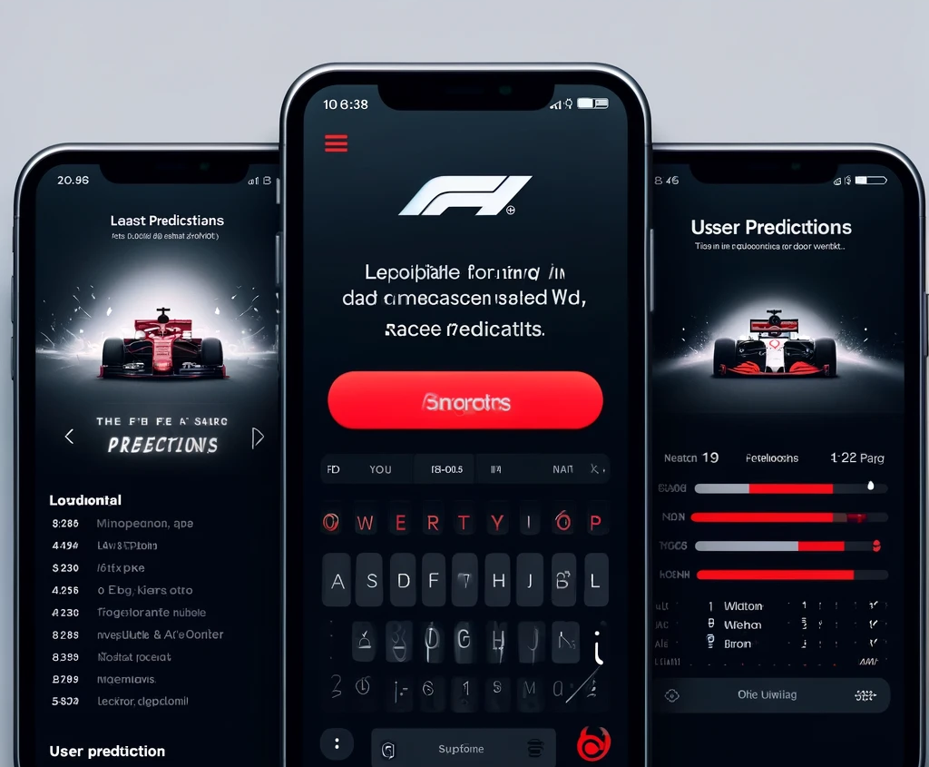

Notes:
"Home Screen: Welcome Message: A brief intro about the app's purpose, leveraging F1 colors and imagery for brand alignment. Latest Predictions: A dynamic section showcasing the AI's latest predictions for the upcoming race, summarizing key insights from Veronica's project. User Prediction Input: A section where users can input their own predictions, with autocomplete suggestions for driver names."

Slide 14
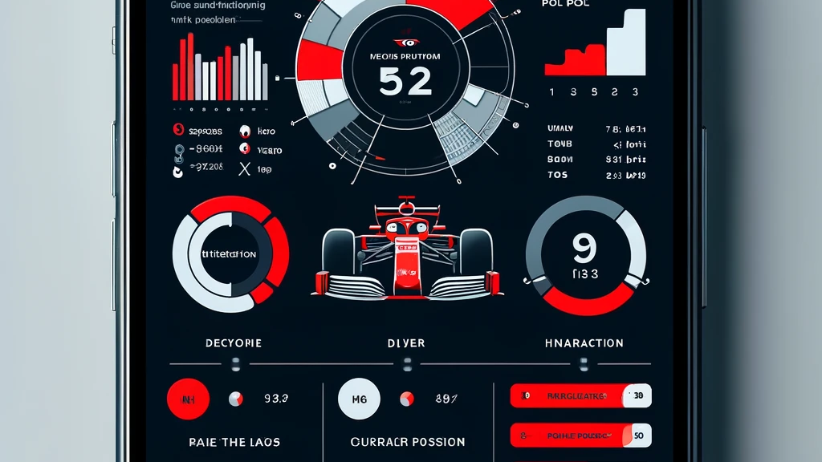
Notes:
Statistics & Insights: Performance Overviews: Interactive charts and graphs summarizing past race outcomes, popular circuits, and the importance of pole position, drawn from the data analysis part of the project.
Driver & Constructor Standings: Current season standings with an option to explore historical data, emphasizing the model's input factors like team performance and driver statistics.

Slide 15
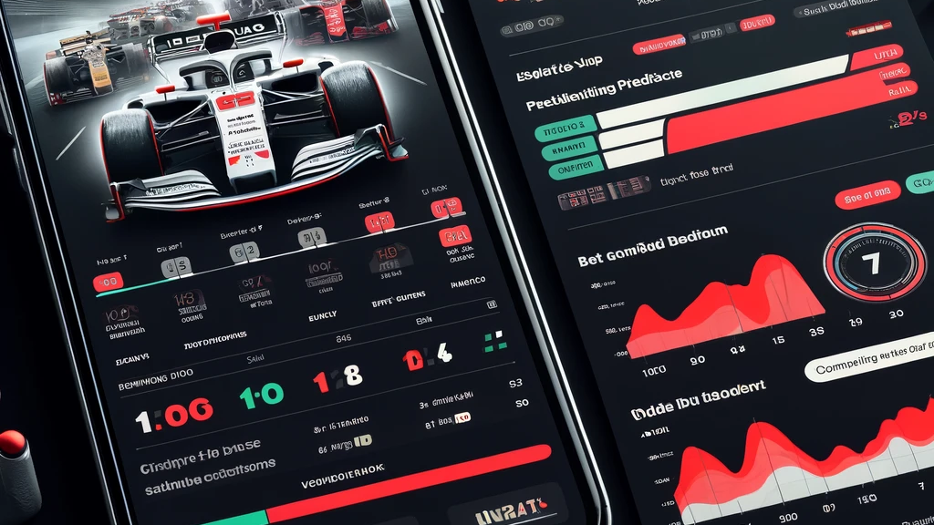
Notes:
Betting Section: Race Winner Bet: Users can select a race, choose a driver, and enter the amount they wish to bet.
Odds Comparison: Display the model's odds against bookmakers, showing potential returns on bets to engage users further.

Slide 16
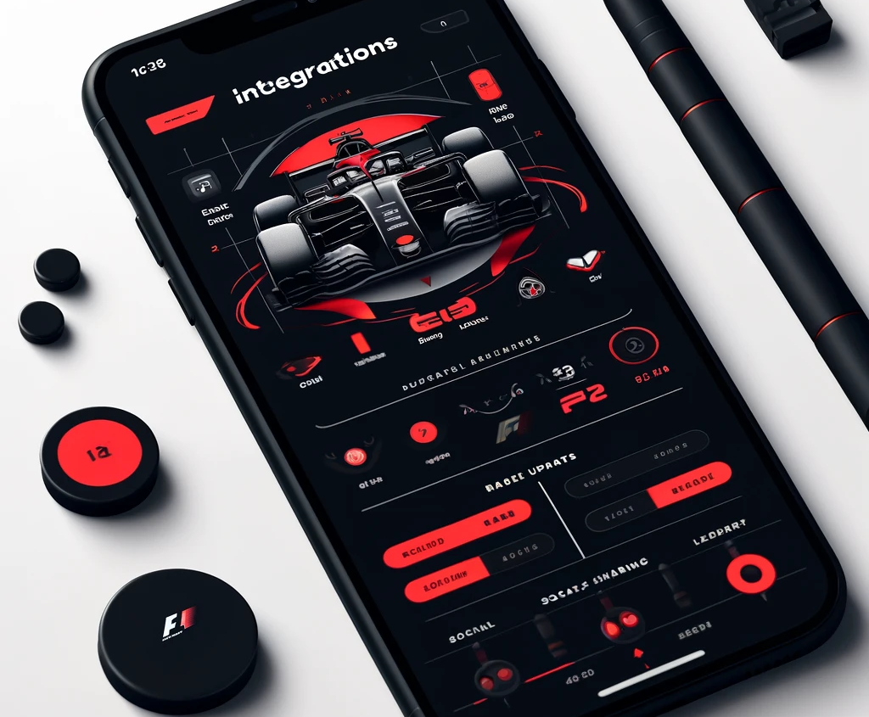
Notes:
"Integrations: 1) Live Updates: Incorporate a live race update feature, providing users with real-time information on race days.
2) Social Sharing: Enable users to share their predictions and results on social media directly from the app, fostering a community of F1 enthusiasts.
3) Leaderboard - there should be a leaderboard for who is doing the best in predictions out of your friends.

